Slide 1
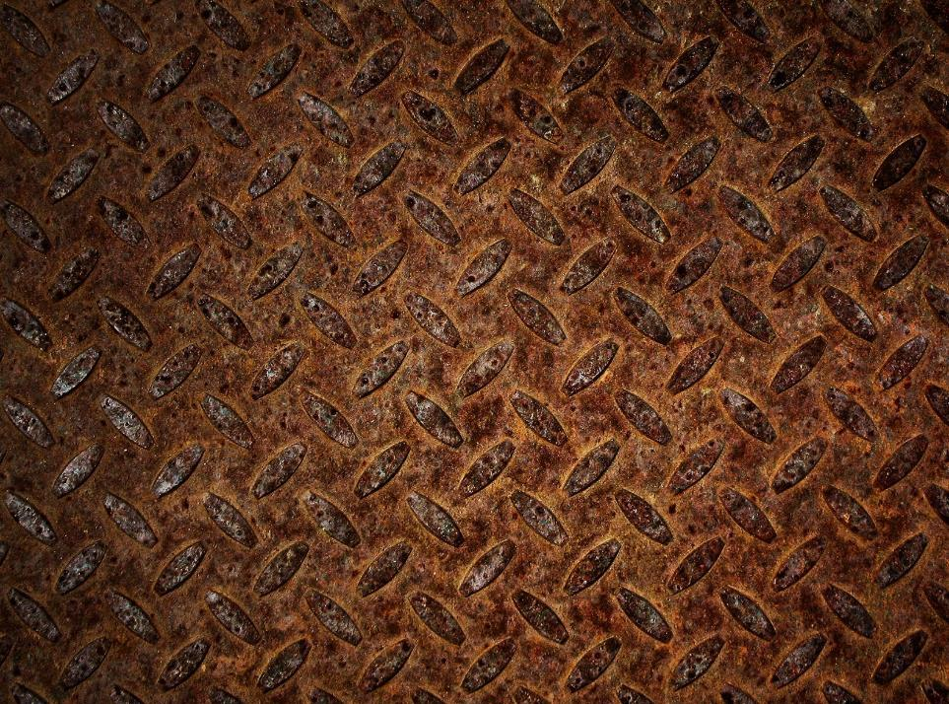
TBS, NPA problem
Genesis: 3 Stage
3 R, SDR, S4A, SARFAESI…
I&B Code 2016
PARA-Bad Bank
Windfall Profit
4R4D
itnaa Hindi kaun taiyaar kartaa hai? When even SDR def. is wrong!

Slide 2
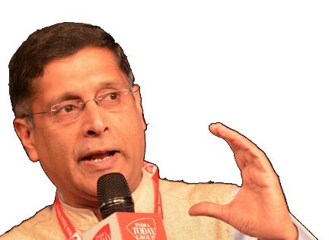
Public Sector Asset Rehabilitation Agency (PARA) or “Bad bank”
SDR
JLF
S4A
I&B Code
SARFAESI, DRT
ARC
AQR & SMA
chocked
5% solved in 2 years
No consensus
2 case solved
Baby-stage
!4C
Court, CBI, CVC, CAG
This Alphabetical soup has failed to treat NPA disease. कुछ यूनिक करना मंगता है.....
Notes:
Gross NPAs of public sector banks increased to Rs606,911 crore while total stressed assets (gross non-performing assets and restructured standard advances) of scheduled commercial banks were Rs9.64 trillion as on 31 December, 2016. As of September-end, the banks’ total stressed loans were Rs897,000 crore. This is a 7.5% growth in stressed loans from September to December-end.

Slide 3
31st Dec 2016: Total NPA in SCB: 9.6 lakh crores
NPA
10 firms
50 firms
Total
20 k cr.
4 lakh cr.
Total: 60 firms
Total 4.20 L.cr NPA
4.20 / 9.6 L.cr = 40% of NPA
Notes:
2017: Government ordered PSBs to conduct “Forensic” audit- find which firms diverted loan money.

Slide 4
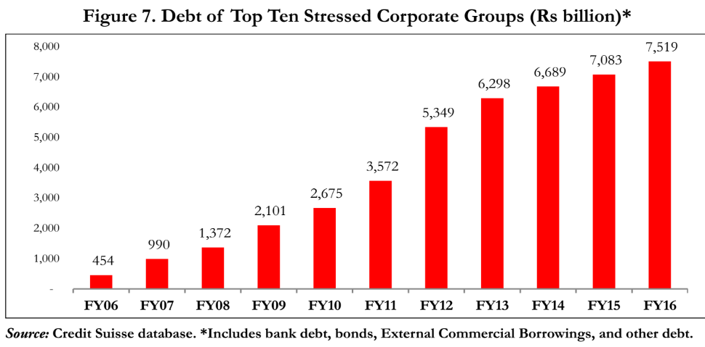
Post-BREXIT, Trumpism, fall of rupee, “BoP crisis”.. Sleeping volcano if not resolved.
4.2 lakh in bank
+ ECB, Bond etc.
= total 7.5 lakh crore

Slide 5
Why PARA
Solving NPA
Only 60 firms we’ve to fix.
Joint lenders forum: no consensus among banks to write off large amount due to 1) !4C 2) public displeasure.
= decentralized effort useless.
Central agency required: hence PARA- this model has been successful in East Asian economies.
Notes:
Phoenix / containment scenario: Time will heal wounds: not yet.
SARFAESI-DRT chocked with cases.
Private ARC – hardly 5% NPA cases solved in last 2 years
I&B codification: will have to try for smaller cases first.
FAILED: Alphabetic soup of schemes e.g. SDR: only 2 sale materialized.

Slide 6
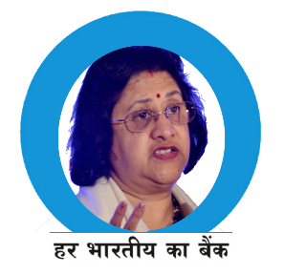




PARA purchases the “Bad loans”
But only from PSB, not PVB
PARA
Convert debt to equity
Shareholders will be hurt [dilution]
If SHUT down-> unemployment [political willingness]
Grant debt reduction /EMI extension
‘Political favoritism’ ; hence PARA should not be >49% Govt ownership like GSTN.
And Manned by professionals, need political willingness
PARA absorb the loss by selling shares..
Debt (NPA)
Equity (Shares)

Slide 7
Issue new G-sec (Debt) = fiscal deficit ☹
PARA-> share issues [govt max 49%] but who’ll buy when ‘dividend’ in unlikely!? ☹
Disinvestment from PSB/PSU
RBI's capital OR, ‘windfall gain’ from demonetization
Top 60 firms:
~4 lakh cr NPA
Even if PARA were to absorb 25% loss
= 1 lakh cr required.
Who will give?
PARA
Since PARA is to absorb the bad loans of PSB…so who’ll finance this loss?

Slide 8

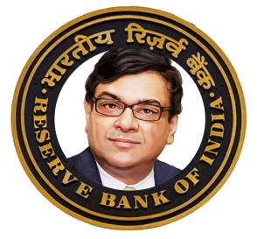
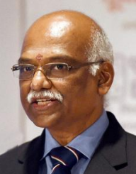
Demonetization= Windfall Profit for RBI? OR NOT??

Slide 9
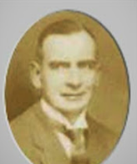



British India: RBI Act 1934
Sir Osborne Smith
1st April 1935
1st January 1949: RBI All private shares transferred to GoI under RBI transfer of ownership act ‘48
Rs. 100 (face Value) x 5 lakh = Rs. 5 cr capital
$$\frac{2200 with Government }{500000 total shares}=4.4\%$$
100%
So, RBI has to pay dividend to Government from its profit
Notes:
1934: RBI
Face value Rs. 100 x 5 lakh shares= 5.cr capital
was a ___ owned bank?

Slide 10
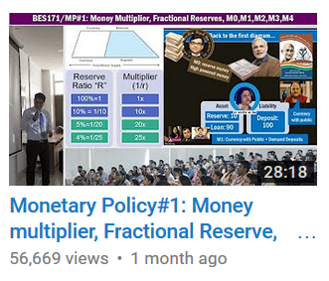

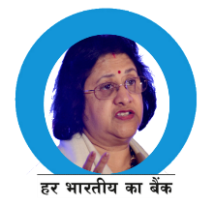
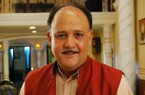
Money Supply
Asset
Liability
M0: reserve money
High powered money
Asset
Reserve: 10
Liability
Deposit: 100
Loan: 90
Currency with public
M1: Currency with Public + Demand Deposits

Slide 11

RBI’s Balance sheet
Asset
Gold
Liability
Foreign Exchange Reserve
Govt Securities
Loans to Banks (Repo, MSF..
Bankers deposit to RBI
Govt's deposit to RBI
Currency in circulation, [+bank, public]
Interest->dividend
M0 or Reserve Money or High powered money
What if some of the currency withdrawn?

Slide 12
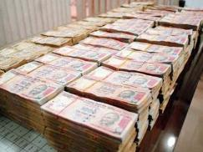
Specified Bank Notes (Cessation of Liabilities) Ordinance, 2016 30/12/16
Demonetization
Exchanging Notes @RBI:
old Rs 500 and Rs 1,000 notes are no longer RBI's liability from 31/12/16.
But union can give grace period to deposit these notes to RBI. (e.g. NRI) with proof.
RBI to credit notes in KYC bank account.
False claims punishment: Rs.50k OR 5x the claim value whichever higher.
Ceiling on holding old notes
Max. 10 notes for individual
Max. 25 notes for research / numismatics
Others allowed by court / RBI.
Else punishment: Rs 10,000, OR 5x the value of notes whichever higher.
2017: Budget session - Specified Bank Notes ( Cessation of Liabilities ) Bill, 2017 to replace this ordinance
Demonatization: impact, positive, negative…later on

Slide 13
RBI’s Balance sheet: special bank notes (SBN)-500, 1000
Asset
Liability
SBN notes in circulation 100 cr.
SBN: total 100 cr.
IF 40% doesn’t return
40 cr. Black money “destroyed”

Slide 14

Basic accounting equation: technically incorrect ofcourse
$$Assets=Net Capital+Net Profit+Liabilities$$
Rs.110 cr
Rs.5 cr
Rs.5 cr
Rs.100 cr

Slide 15
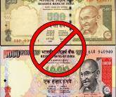

Basic accounting equation: technically incorrect ofcourse
$$Assets=Net Capital+Net Profit+Liabilities$$
Rs.110 cr
Rs.5 cr
Rs.5 cr
Rs.100 cr
Rs.110 cr
Rs.5 cr
Rs.5 cr
+Rs.40 cr
Rs.60 cr
Larger dividend to Government
Notes:
Or directly transfer ‘reserve’ to Government with Central board’s approval
Or purchase G-sec on asset side, to ease liquidity

Slide 16
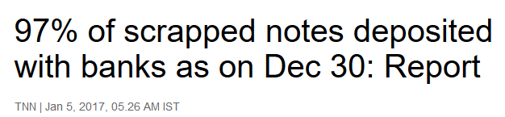
Counter argument : it’s not ‘windfall profit” for RBI because
Exchanging old notes, printing new notes…KHARCHAA..say 1 cr.
$$Assets=Net Capital+Net Profit+Liabilities$$
Rs.110 cr
Rs.5 cr
Rs.5 nahi 4 cr
Rs.100 cr
4 +3cr=7 cr.
Rs.110 cr
Rs.5 cr
Rs.97 cr
Windfall is only7-5= 2 cr.=> OMO purchase G-sec=> ease liquidity, “remonetization”

Slide 17
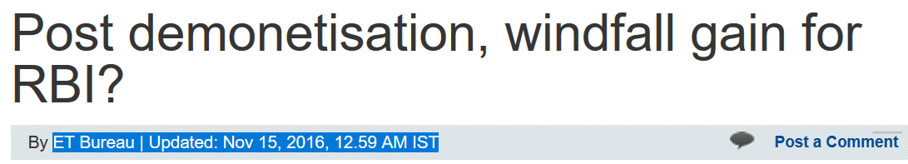
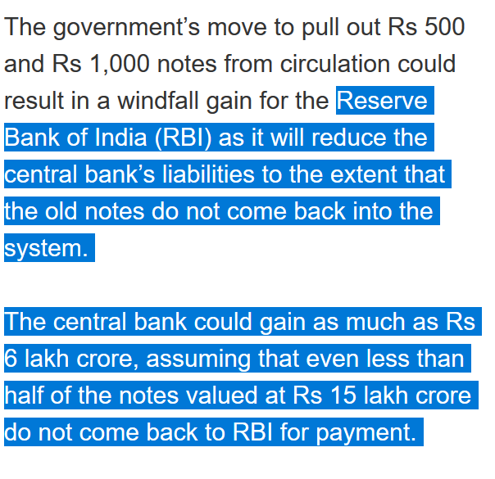
News one week after demonetization of 8th November 2016
SBN: total 15 lakh cr.
IF 40% doesn’t return
6 lakh cr.
1978’s demonetization = 25% banned currency did not return.

Slide 18
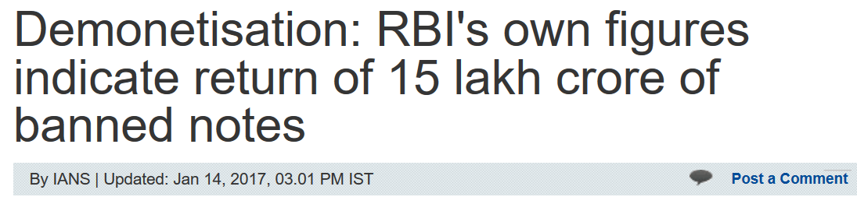
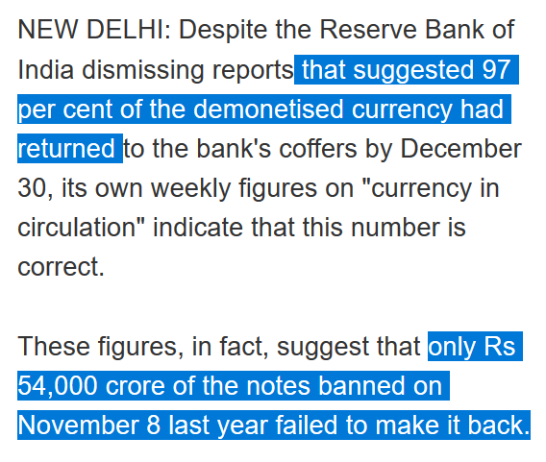
News after two months!!
SBN: total 15 lakh cr.
3.6% didn’t return
Rs.54,000 cr black money destroyed
+ cost of printing and transporting new currency = >16,000 crs +OMO
Notes:
http://economictimes.indiatimes.com/news/economy/finance/recall-could-cost-a-massive-rs-1-28-lakh-crore-says-cmie/articleshow/55608552.cms

Slide 19
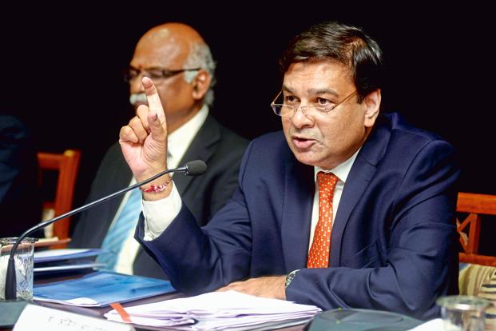
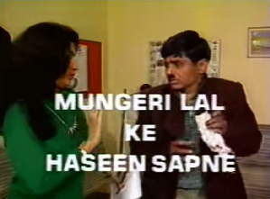

There is a speculation about special dividend to be paid by RBI owing to extinguished liabilities after demonetisation. What is your stance on this demand?
The withdrawal of legal tender status does not extinguish anything from RBI’s balance sheet. There is no question of special dividend. (Dec. 8, 2016)
Public Debt fiscal deficit▼
BASEL-III recapitalization
PARA to absorb NPA
UBI
Notes:
http://profit.ndtv.com/news/economy/article-no-windfall-for-government-from-undeposited-old-notes-says-rbi-chief-urjit-patel-1635223
http://economictimes.indiatimes.com/news/economy/finance/demonetisation-no-special-dividend-for-government-says-urjit-patel/articleshow/55862142.cms

Slide 20
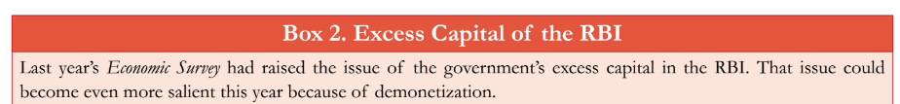
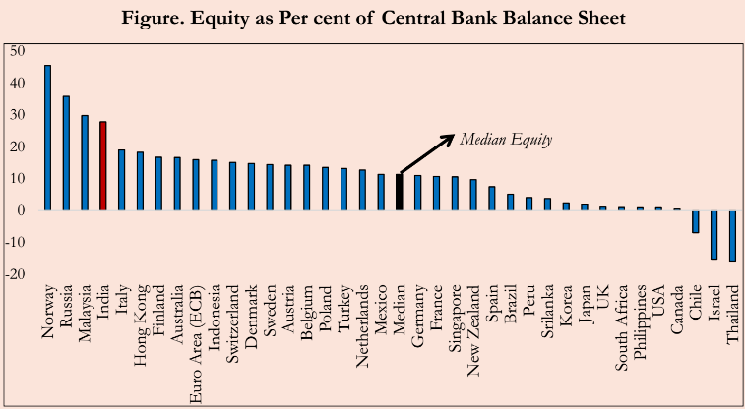
if not windfall profit, then use excess capital RBI already has..
1991 BoP crisis
Forex Reserve
RBI’s Capital as cushion
Trumpism, strong dollar

Slide 21
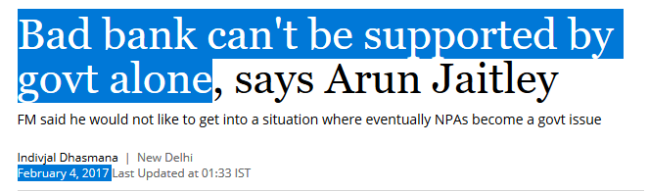
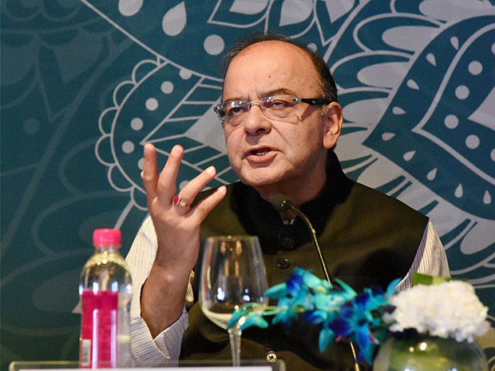
Already giving 10k crore for Indra-
The tiger dhanush! ☹
Notes:
How much is possible?
Disinvestment: ~72500 Cr.
MINUS Indradhanush (10k cr)
Net borrowing: 3.5 trillion (2017)
Fiscal deficit 3.2% of GDP

Slide 22
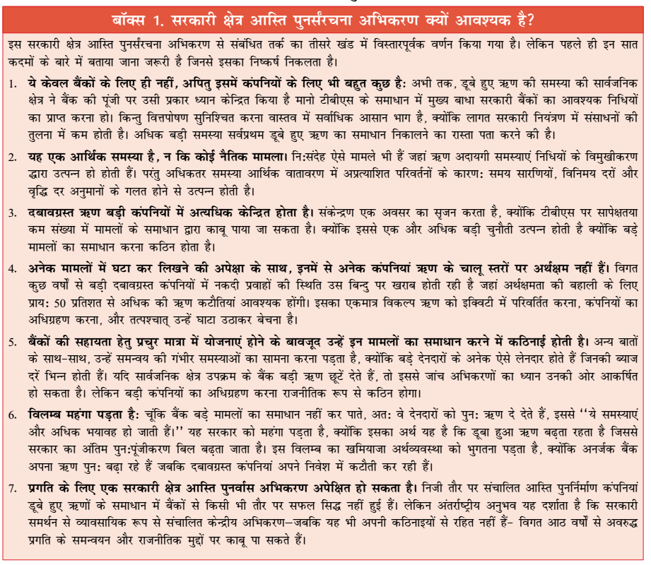
For Mains answer writing

Slide 23
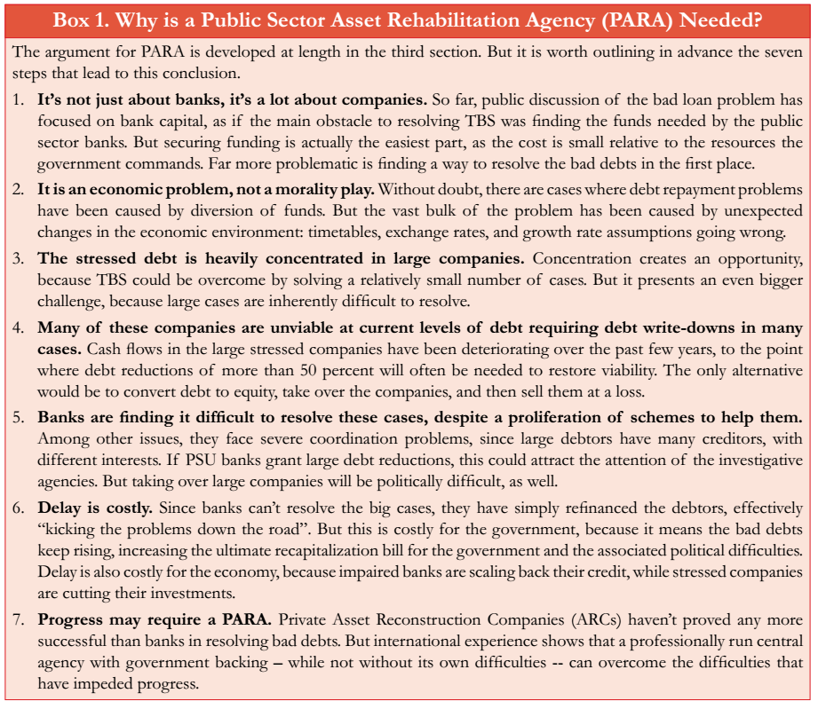
For Mains answer writing

Slide 24
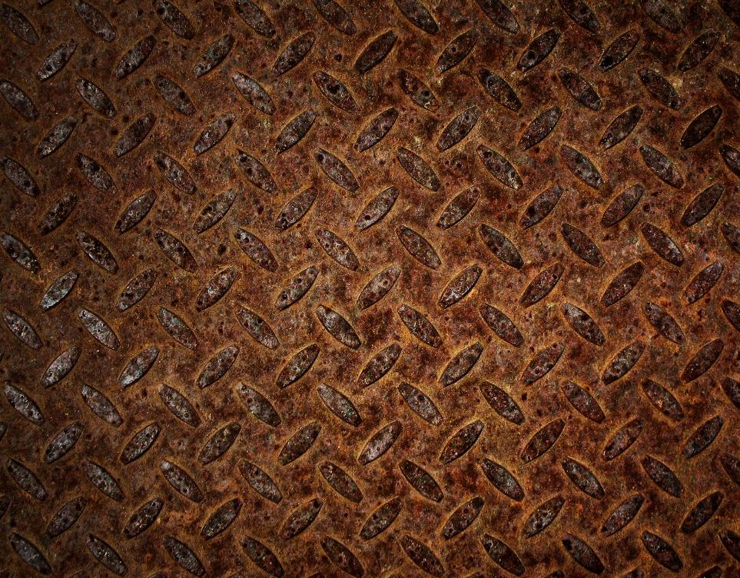
TBS, NPA problem
Genesis: 3 Stage
3 "R“, SDR, S4A
I&B Code 2016
PARA-Bad Bank
Windfall Profit
4R4D

Slide 25
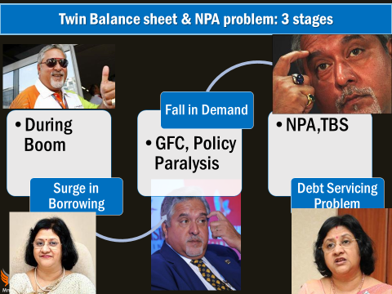
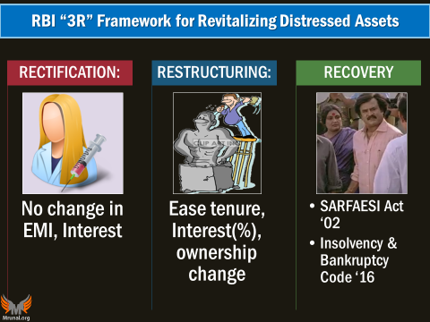


5/25, SDR, S4A
I&B Code 2016
“Moral Hazard”: even if fix NPA, then bankers will start CARELESS Lending!!

Slide 26





Governance structure of PSB?
PSB: Shareholders
Board of Directors
Chairman
Managing Director
Operation
Profit->Dividend
Political elements, Agenda ☹

Slide 27
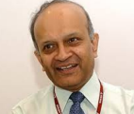
RBI’s own PJ Nayak Committee (2014)
PSB “subsidiary co”.
Board of Directors
Chairman
Managing Director
Operation
Profit->Dividend
RBI 2016, Jul.
Investors may shy away due to holding company structure.
Then BASEL-III recapitalization difficult ☹
Banking Investment Company (BIC) as holding co.

Slide 28
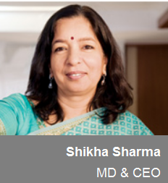
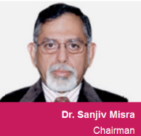


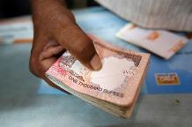
Now this is done in PSBs as well, + private professionals can apply
Bifurcation of CMD post
Chairman alag
MD(CEO) alag
PROFIT
Board of Directors
DIVIDEND
SHARE-HOLDERS
Notes:
Dividend has to be distributed acc. To shareholding
How can Biyani make more than his share holding? Ans. Royalties!

Slide 29
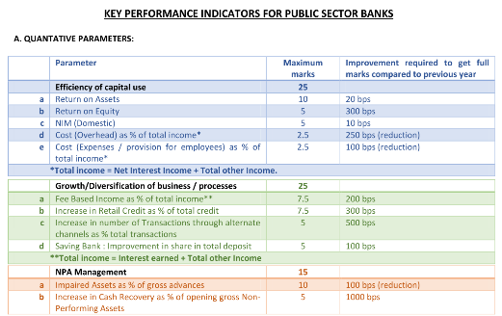
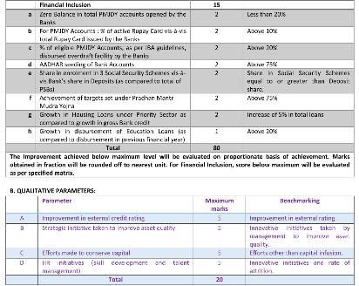
Indradhanush: Key Performance Indicators (KPIs): 4 sections 100 marks
Performance bonus to MD & CEO linked to this score
Notes:
Earlier system- SoI – Statement of Intent between PSB and FinMin but slow, and problematic.
A new framework of Key Performance Indicators (KPIs)

Slide 30
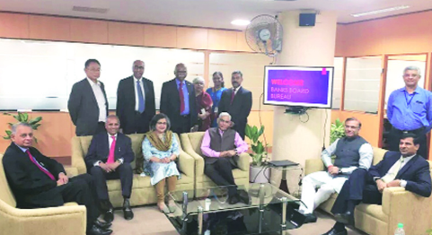

But who will select PSB Bankers in professional manner?
BBB recommended by
2014: P J Nayak Committee
2015: Gyan Sangam (Pune)
2015: Budget
2016, April: Operational

Slide 31
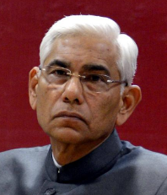

Structure: Bank board bureau (WEF 1/4/2016)
Article 148 (4): CAG not eligible for further office under Union/State Government ????
Chairman
Vinod Rai (former CAG)
3 Members:
1. Anil K Khandelwal (Ex-BoB)
2. HN Sinor (Ex-ICICI)
3. Rupa Kudwa (EX-CRISIL)
3 Ex-officio
1. Financial services secretary
2. Dy. Gov. RBI
3. secretary public enterprises
Search Committee
1. RBI governor
2. secretary, financial services
3. secretary, Department of Personnel and Training.
2 years term

Slide 32
GSM2: BBB functions
Accountability
Help create a holding company (BIC, PJ Nayak)
Help in Bank Consolidation/M&A: from present 27 PSB=> 10
Raise capital and help recover from NPA
Org. Reform
Financial Reform
To improve governance at PSB
Link between the government and banks
Search and select:
Heads of PSB (MD & CEO)
Non-Executive Chairman
Whole time directors

Slide 33
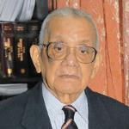
Banking sector Reforms: Narsimhan-III ?
+SURVEY: 4R AND 4D
RBI’s P.J.Nayak Committee 2014 BIC, BBB
Indradhanush 2015-Aug,
Dept. Financial services
Gyan Sangam-II Gurgaon-2016 Bank Consolidation
Gyan Sangam-I Pune-2015, Jan BBB
FinMin
RBI, Regulators
PSB
Insurance, FI
Appointments- CMD bifur.
Bank Board Bureau (BBB)
Capitalization (70kcr)
Empowerment
Framework of Accountability
Governance Reforms
BMB
Asso.Banks
IDBI
Narsimhan I & II
Notes:
Non-interference by Government in bank operations.
Grievances Redressal Mechanism for customers and Staff
Gyan Sangam conclave for PSB, FI, Government
Guru Dronacharya; the village was given as “gurudakshina” to him by his students, the Pandavas,

Slide 34





Twin Balance Sheet Syndrome –how to fix?
Survey-2015 (4R)
Resolution
Reform
Diversify
Recognition
Survey-2014 (4D)
Recapitalize
Disinter
Differentiate
Deregulate
Notes:
4d – PSB
4r PSB + Corproates
Dis-inter= takeout of graves with safaesi and bankruptcy codes.

Slide 35
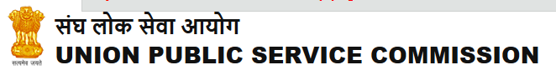
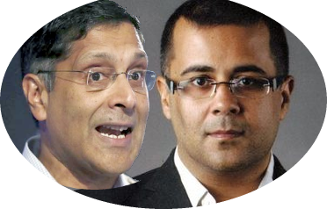

I’m Arvind Subramanian of English fiction
UPSC got into habit of asking “Contemporary” topics that are ~1.5-2 years old (WEF Prelim-2016)
“BES17” series
Compress, consolidate old material
Update with new developments
FAST Revision
I’m Chetan Bhagat of Economic surveys
…same themes repeated in
3 surveys that Arvind has written
NPA: 1st survey: “NPA renegotiation commission”,
3rd survey “PARA- Bad Bank”
Tax, Labour, Subsidy reform,
So, Now observe….

Slide 36
Economic Survey-2015: “4R” Economic Survey2014: “4D”
Recognition
of bad loans via asset quality review (AQR)
Resolution
via ALPHABETICAL soup
5/25, SDR, S4A, JLF, SARFAESI...
Recapitalization
for BASEL-III norms
Government, Market, RBI should give
REFORMs
Governance & Administration of PSB
We saw in earlier slides
Disinter "Digup graves"
SARFAESI-DRT empower
Independent renegotiation Commission (PARA?)
Differentiate among PSB
Profit Maker PSB: capitalize for BASEL-III
Loss Maker PSB: Merge, Privatization
Diversify
More number, variety of Banks
Deregulate
Lower SLR, [yes 22%->20.5%]
Promote C-Bond so they borrow less from Banks. [Tri-Party Repo, etc.]
SFB, PB…now Wholesale Bank [will learn in classification lecture]

Slide 37

But how exactly to “WRITE” in mains?
2015 (=2014’s survey)
V1c5: Only page 88 (4d reforms)
2016 (=2015’s survey)
V1c1 box 1.6
2017 (=2016’s survey)
V1c4 (TBS): intro, conclusion , PARA bad bank

Slide 38
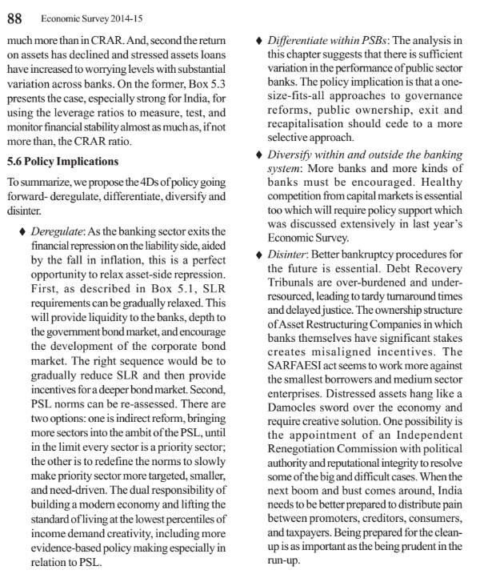
Survey 2015
4D
English

Slide 39
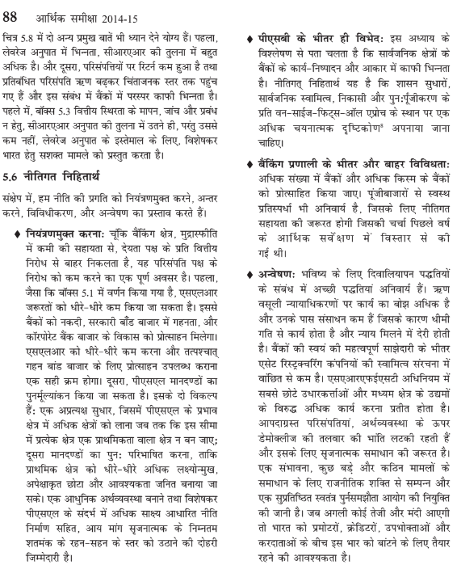
Survey 2015
4D
Hindi

Slide 40
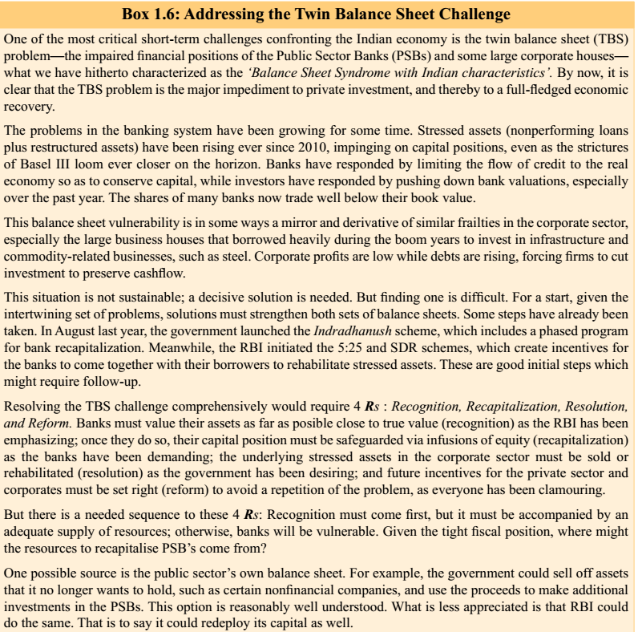
Survey 2016
4R
English

Slide 41
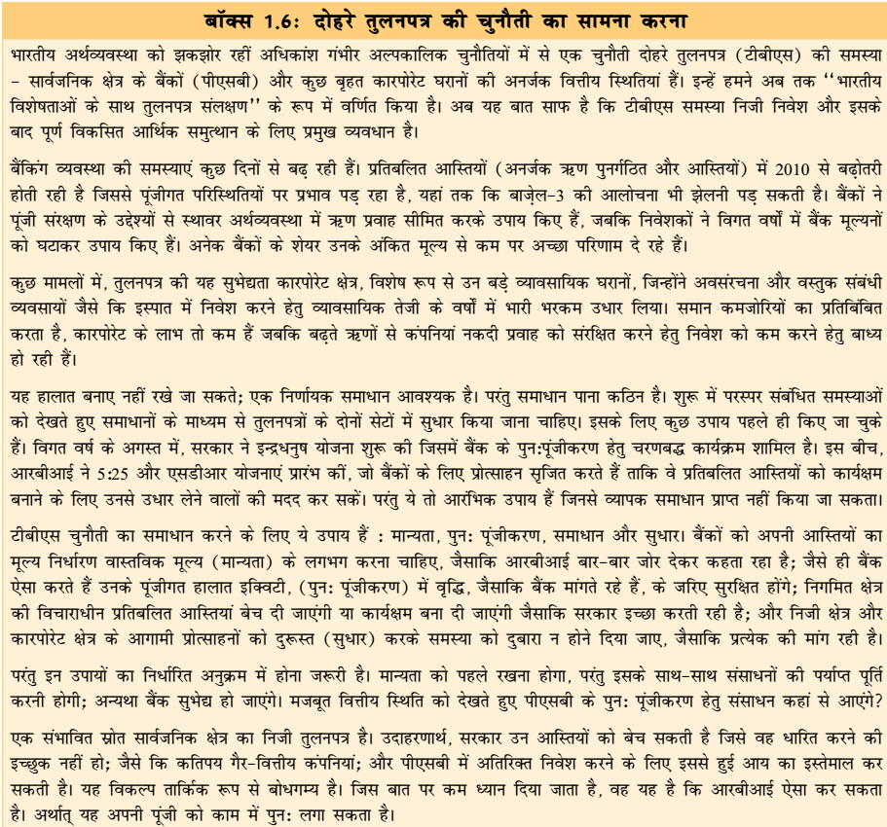
Survey 2016
4R
Hindi
Survey 2017
Self study
v1C4 (TBS)
Box.1 (PARA)

Slide 42
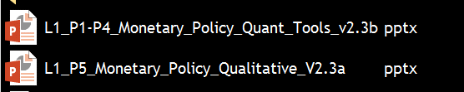
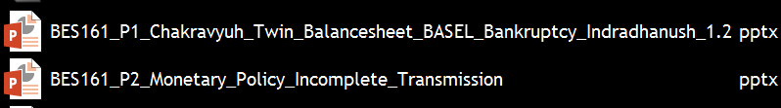
Old material is “Demonetized” and “Decontentized”

Slide 43
TBS, NPA problem
Genesis: 3 Stage
3 R, SDR, S4A, SARFAESI…
I&B Code 2016
PARA-Bad Bank
Windfall Profit
4R4D

Slide 44


BES171: Banking, Finance & Insurance
Money Evolution
Monetary Policy
Evolution & Classification of FI
Digital Payment
BASEL, NPA, TBS, Bad Bank-PARA
Finance, Insurance & Fin. Inclusion

Slide 45
Economy: 6 pillars + theory + current + BES17 (pre cum Mains)
1.Banking
6.HRD
2.Budget
3.BoP
4.Sectors
5.Infra
V1:c3,4
V1:c2,3,5,6,9,11(GST),12,13
V1c:5
V1c:7,11(Agri)
V1c:10
v1c:12, 14; Budget^Rail
Banking|Finance|insurance|inclusion

